Slide 1
The root cause of unavailability and delay to innovative medicines: Reducing the time before patients have access to innovative medicines
Report summary
14th April 2023

Slide 2
Contents
1
Objective of the analysis
2
Findings
3
Conclusions

Slide 3
Contents
1
Objective of the analysis
2
Findings
3
Conclusions

Slide 4
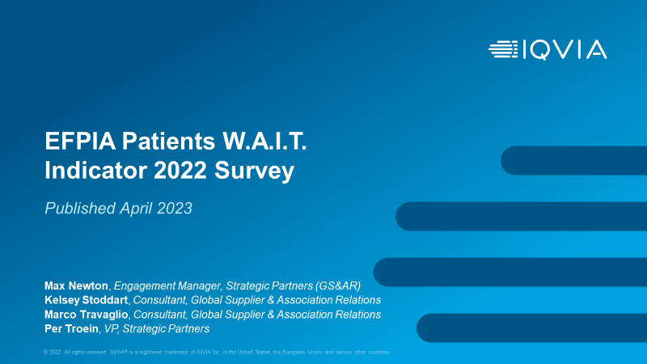
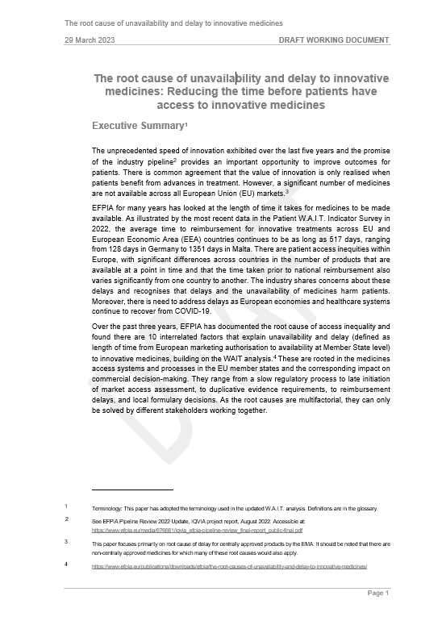
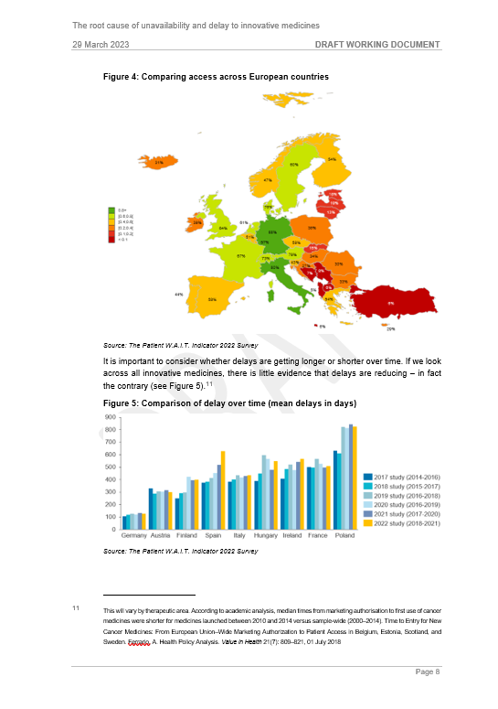
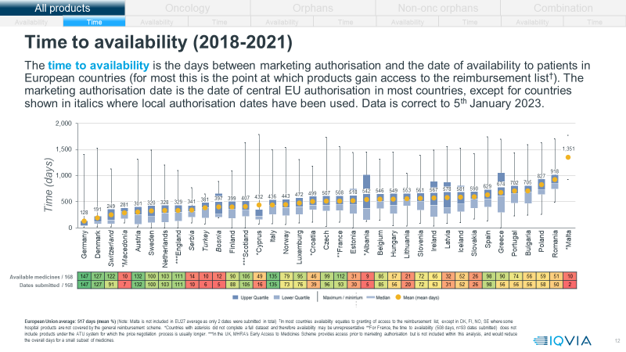
The report explains the root causes of unavailability of products across European countries
The W.A.I.T. Indicators & Root Causes
The unprecedented speed of innovation exhibited over the last five years and the promise of the industry pipeline provides an important opportunity to improve outcomes for patients
There is common agreement that the value of innovation is only realised when patients benefit from advances in treatment
However, a significant number of medicines are not available across all European Union (EU) markets
EFPIA has studied this through the W.A.I.T. Indicator Survey for many years and has asked CRA to support an analysis of the root cause of delays in availability of medicines in the EU
This report summarizes the fourth edition of the root cause analysis, first released in June 2020 and used as a basis for discussion with several EU and national policy-makers and stakeholders
EFPIA Patients W.A.I.T. Indicator – IQVIA report
The root cause of unavailability and delay to innovative medicines – CRA report
Focus of this report

Slide 5
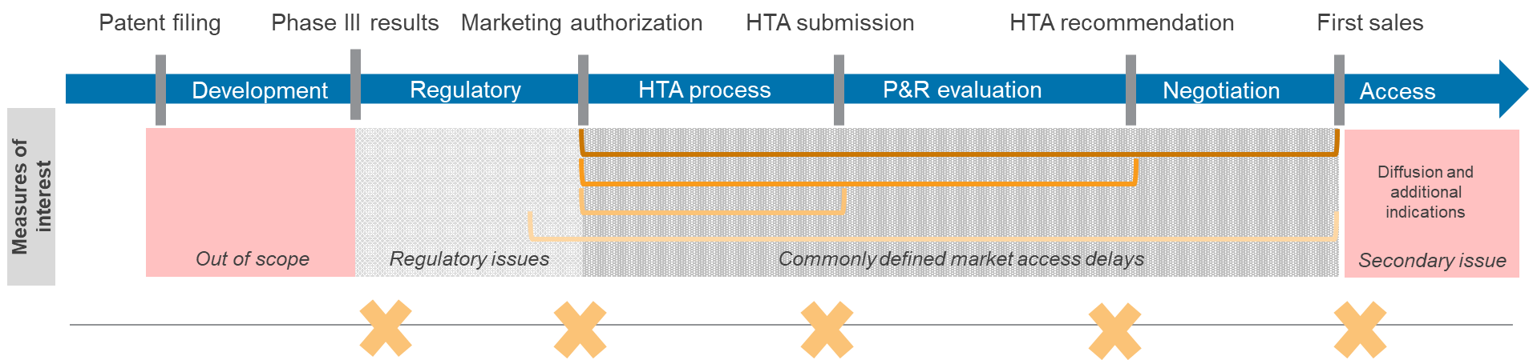
What do we mean by availability and delay?
In the European Union, once a new treatment has gone through a process of research and development lasting ten years on average, three further milestones have to be reached prior to patient access
It is important to distinguish between a number of different time points:
  The length of time between application for and the granting of marketing authorisation
  The length of time from market authorisation to application for price and reimbursement
  The length of time from application for price and reimbursement to decision on value assessment
  The length of time from decision on value assessment to reimbursement decision
Types of delay in the availability of medicines
Source: CRA analysis

Slide 6
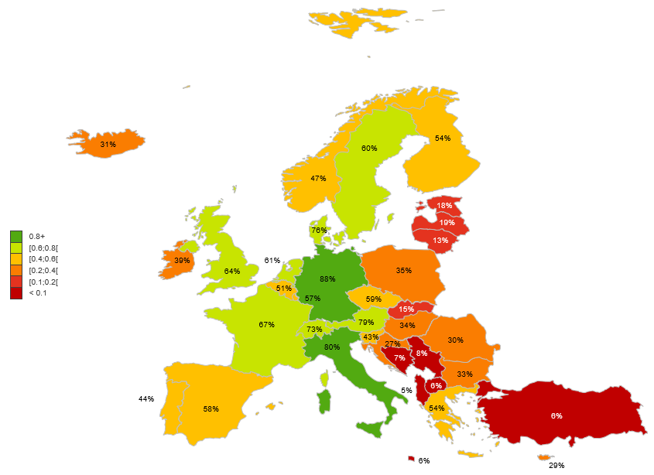
What is the evidence on unavailability and delays?
Comparing availability across European countries¹
There is wide variation in time to availability and available across Europe
There is also evidence that shows systematic differences between different types of medicines
  Although access to oncology medicines appears to be improving, access to orphan medicines continues to vary considerably across EU member states, with long delays and low availability in central and eastern Europe
Even within one country, patients can get access to some medicines almost immediately, and wait years for others
Across all innovative medicines, there is little evidence that delays are reducing – in fact the contrary
Sources: [1] Patient W.A.I.T. Indicator 2022 Survey

Slide 7
Contents
1
Objective of the analysis
2
Findings
3
Conclusions

Slide 8
We find and document 10 interrelated factors that explain unavailability and delays
Time prior to marketing authorisation
The price and reimbursement process
The value assessment process
Health system readiness
Delays from national to regional approval
Category
1. The speed of the regulatory process
3. Initiation of the process
5. Misalignment on evidence requirement
8. Insufficient budget to implement decisions
10. Multiple layers of decision making processes
2. Accessibility of medicines prior to marketing authorisation
4. The speed of the national timelines and adherence
6. Misalignment on value and price
9. Diagnosis supporting infrastructure and relevance to patients
Potential root causes
7. The value assigned to product differentiation and choice
These causes are rooted in the medicines access systems and processes in the EU member states and the corresponding impact on commercial decision-making
In reality, there are many interconnected factors that could explain unavailability and it is not possible to untangle their impact with perfect precision: the environment affects commercial decisions
Source: CRA analysis

Slide 9
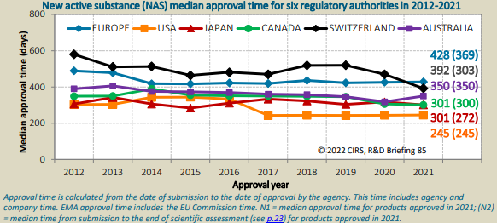
The speed of regulatory process
Time prior to marketing authorisation
The price and reimbursement process
The value assessment process
Health system readiness
Delays from national to regional approval
Although this not is captured in EFPIA’s W.A.I.T. indicators, the time from application to granting of marketing authorisation has been examined in many different papers
  Evidence consistently shows that the EMA is slower than the FDA
To highlight this disparity, many studies have focused on cancer medicines, for example:
  For 37 cancer medicines approved between 2005 and 2013, the time from date of filing for MA to approval was much longer for the EMA¹
  The latest evidence suggests these trends remain unchanged: a 2022 study found that between 2010 and 2019, the FDA approved 95% of new oncology therapies before the EMA, with a median delay to market authorisation in Europe of 241 days²
For other categories of medicines, the difference may be smaller, but the FDA is still faster than the EMA
Comparison of length of time of market authorisation process³
Abbreviations: EMA = European Medicines Agency; FDA = Food and Drug Administration
Sources: [1] Samuel, N. and Verma, S. (2016) Cross-comparison of cancer drug approvals at three international regulatory agencies. Current Oncology 23(5): 454–460; [2] Lythgoe, M. et al. (2022) Cancer Therapy Approval Timings, Review Speed, and Publication of Pivotal Registration Trials in the US and Europe, 2010-2019. JAMA Netw Open 5(6): e2216183; https://cirsci.org/wp-content/uploads/dlm_uploads/2022/06/CIRS-RD-Briefing-85-6-agencies-v2.3.pdf

Slide 10
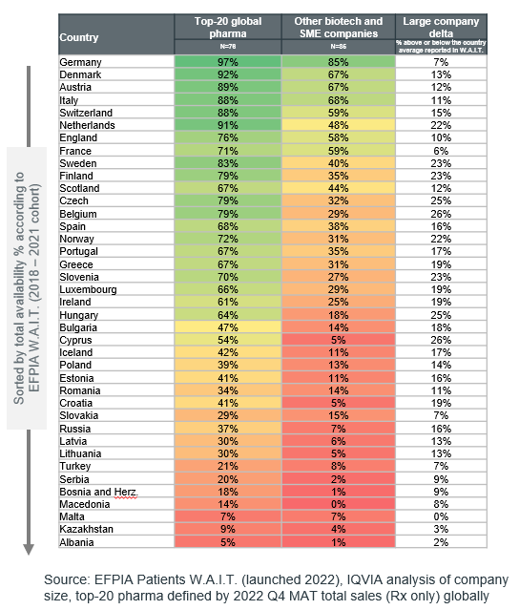
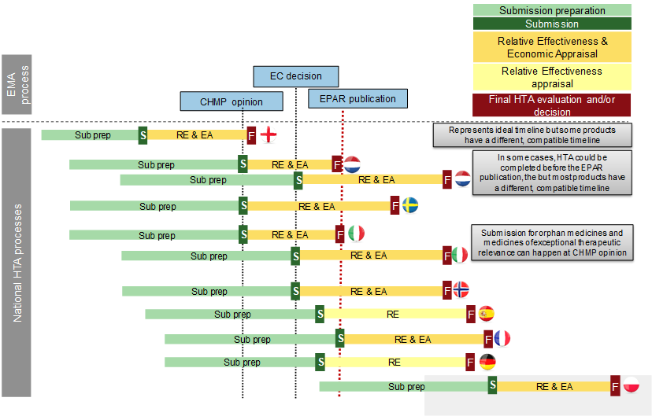
Initiation of the process and length of P&R process
Time prior to marketing authorisation
The price and reimbursement process
The value assessment process
Health system readiness
Delays from national to regional approval
Percentage of products available in EU countries, segmented by company size¹
In a minority of markets, there is immediate access after MA, at least for some products
However, in many markets the P&R process does not start automatically; this requires a submission by the company or decision by those in the assessment process
Delays in initiating the P&R process occur for various reasons:
  External reference pricing
  The time-consuming nature of the P&R application process including tailor-made dossiers for each country
  Rules around the timelines for decision-making , including reliance on decisions from other countries
Time until the reimbursement process can be initiated²
Abbreviations: P&R = pricing and reimbursement; MA = marketing authorization
Sources: [1] Patient W.A.I.T. Indicator 2022 Survey, IQVIA analysis of company size, top-20 pharma defined by 2022 Q4 MAT total sales (Rx only) globally; [2] EFPIA; EPAR refers to European public assessment report

Slide 11
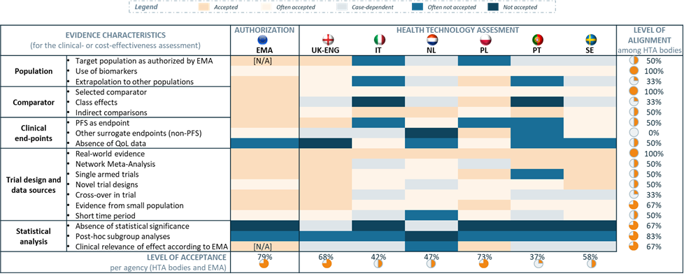
Misalignment on evidence requirement
Time prior to marketing authorisation
The price and reimbursement process
The value assessment process
Health system readiness
Delays from national to regional approval
Once the P&R process is initiated national timelines get extended due to stop-clocks, request for information or rejections during the HTA process
Misalignment can be found in all assessment criteria including:
  Patient population
  Comparators
  Trial design
  End points
  Statistical analysis
To illustrate the differences in evidence requirements, we can compare the evidence requirements of EMA and the HTA bodies
Evidence requirements vary between agencies, prolonging national discussions and decision-making¹
Abbreviations: P&R = pricing and reimbursement; HTA = health technology assessment; EMA – European Medicines Agency
Sources: [1] Time to Patient Access, Vintura (July 2020)

Slide 12
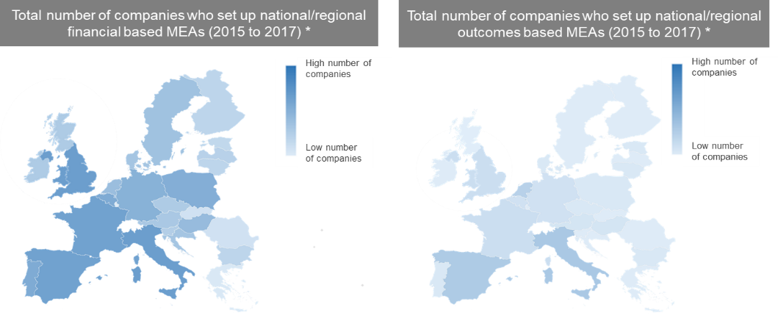
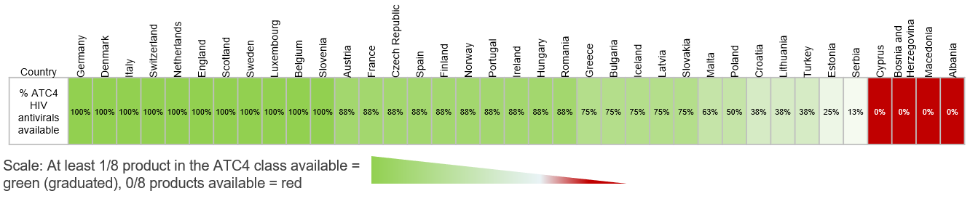
Misalignment of value and price and the value assigned to product differentiation and choice
Time prior to marketing authorisation
The price and reimbursement process
The value assessment process
Health system readiness
Delays from national to regional approval
Even if there is agreement on the evidence regarding the value of a medicine different countries have different level of income and hence ability to pay
Where prices are higher than the perceived value or affordability, there is an inevitable delay as the price is negotiated
Where it is possible to use flexible contracts to align price and value, this should reduce delays
The value that countries place on a particular medicine also varies due to:
  Clinical and epidemiological factors
  Physician choice
  Value of competing medicines
The use of managed entry agreements across Europe¹
Number of products available in a therapeutic class
(the example of HIV antivirals)²
It is often the case that some products in a class are available, even if the number of products varies between countries. As illustrated by HIV antivirals (J5C9):
Abbreviations: MEA = managed entry agreement
Sources: [1] EFPIA “MEAs and innovative pricing models: Real world experience” Final Report 2018; [2] Patient W.A.I.T. Indicator 2022 Survey, IQVIA ATC4 class (J5C9, HIV antiretrovirals, n=8)

Slide 13
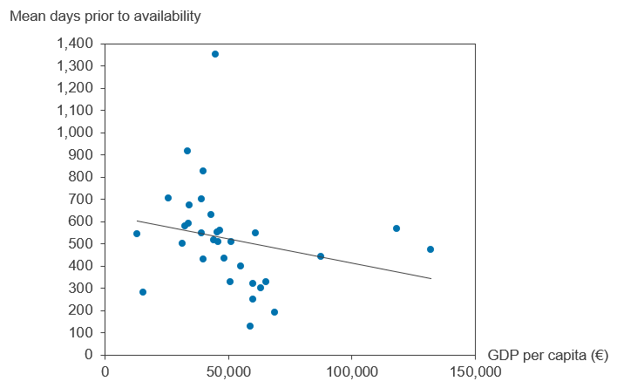
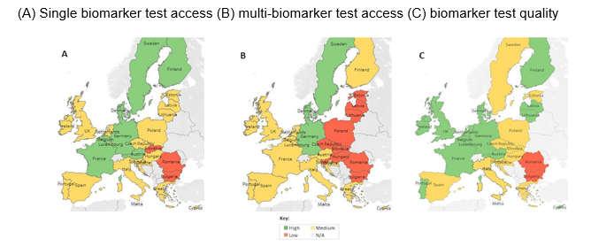
Health system readiness
Time prior to marketing authorisation
The price and reimbursement process
The value assessment process
Health system readiness
Delays from national to regional approval
Relationship between time to availability (delays) and GDP per capita²
\\\\
Insufficient budget to implement decisions
Within Europe, we have countries with very different levels of income – with GDP per capita varying from €13,000 to €132,000 per annum – and healthcare investment decisions¹
Given the difference in income and spending on healthcare and medicines, it is unsurprising that the market potential varies across European countries
Diagnosis, supporting infrastructure and relevance to patients
Accurate and timely diagnosis is dependent on the availability of accessible screening and diagnosis programs and services
Even where diagnosis programs exists in a country, access to diagnostic testing can be limited (e.g., uptake of biomarker testing for precision oncology)
Diagnosis requires investment in reimbursement of diagnostics, appropriate investment in testing facilities but also requires investment in physician education
Given the small number of patients, Centers of Excellence (CoEs) are key, but these are not evenly developed
Access to precision oncology biomarker testing in Europe (2022)³
\
Abbreviations: GDP = gross domestic product
Sources: [1] OECD. (2022). Gross domestic product (GDP). Available at: https://data.oecd.org/gdp/gross-domestic-product-gdp.htm; [2] The Patient W.A.I.T. Indicator 2022 Survey, OECD 2022; [3] Normanno, N. et al. (2022) Access and quality of biomarker testing for precision oncology in Europe. European Journal of Cancer 176: 70-77.

Slide 14
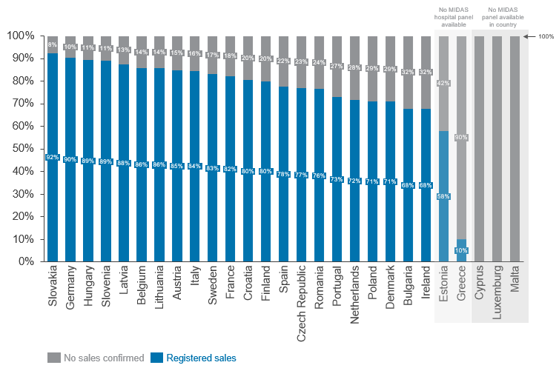
Availability is not access
Time prior to marketing authorisation
The price and reimbursement process
The value assessment process
Health system readiness
Delays from national to regional approval
Even once a medicine is on the public reimbursement list and navigated any regional process, this does not mean that patients have access to medicines
There are many additional barriers that affect usage of medicines including:
  Publication in the national gazette
  Clinical guidelines that do not always include the most recent therapeutic innovations
Percentage of available products with no recorded sales in the EU¹
Sources: [1] IQVIA MIDAS sales data 2015-2022. Analysis includes all available products (2018-2021). 'Sales' is defined as available in WAIT indicator and shows EU sales in IQVIA MIDAS. 'No sales' is defined as available in WAIT indicator and shows no EU sales in IQVIA MIDAS. No sales is defined as no sales found in IQVIA MIDAS data since 2015. Some countries in this analysis are not covered by IQVIA data, or do not cover the hospital channel (coverage is retail only).

Slide 15
Contents
1
Objective of the analysis
2
Findings
3
Conclusions

Slide 16
Policy solutions to improve availability of innovative medicines
Industry commitment:
Proposals to speed up the regulatory process, delivering safe and high-quality diagnostics, vaccines and treatments to patients as fast as possible |  | Shared aspiration to reduce regulatory approval times in Europe and bring these in line with international best practice
Proposals that aim to increase transparency of information regarding the placing on the market of centrally approved products |  | Industry-launched European Access Hurdles Portal for transparency of P&R applications
Proposals to facilitate a process that allows prices to align with value and ability to pay |  | Development of novel pricing and payment models
Proposals to improve the efficiency and quality of value assessment |  | An efficient system of European HTA assessments
Proposals to ensure equity of access and solidarity across EU member states |  | Conceptual framework for Equity-Based Tiered Pricing (EBTP)
1
2
3
4
5
Abbreviations: P&R = pricing and reimbursement; HTA = health technology assessment

Slide 17
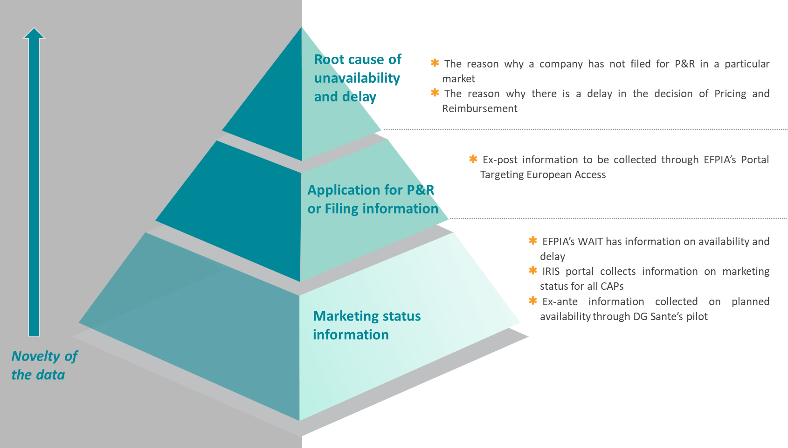
The report highlights the launch of the European Access Hurdles Portal
Potential for more granular data on unavailability and delay
The portal targets European Access to provide additional transparency regarding patient access and insights into the root causes of unavailability and delays
Over 90% of EFPIA members with products eligible for inclusion in the Portal submitted data on P&R filling, which is not collected by any existing databases
Preliminary results support the multifactorial causes of unavailability and document that it is a shared responsibility, requiring a shared solution
Abbreviations: P&R = pricing and reimbursement

