Slide 1
European Access Hurdles Portal:
Report summary
20th April 2023

Slide 2
The industry created the European Access Hurdles Portal to add new information to the debate on availability of innovative medicines
Created in April 2022, the role of the Portal is to improve transparency regarding the root causes of unavailability and delay, including the role of the environment and its corresponding impact on commercial decision-making
2010 – First report on the Patients W.A.I.T. (Waiting to Access Innovative Therapies) Indicator
2020-2022 – Annual reporting on Patients W.A.I.T. Indicators and root causes of unavailability
April 2022 – Industry commitment to the creation of the European Access Hurdles Portal
April 2023 – Release of the first public report from the Portal

Slide 3
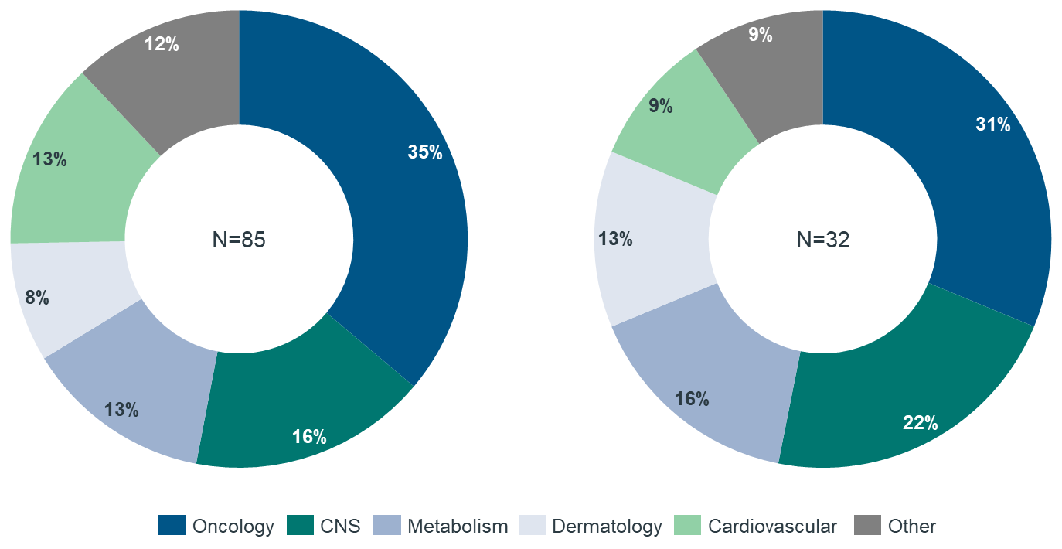
Results indicate a clear willingness from industry to provide more transparency on the root causes of unavailability
Industry participation
Data completeness and representativeness
Data on 32 products were submitted to the Portal.
All received European marketing authorisation between January 2021 and June 2022.
Therapy areas of products approved by the EMA between Jan 2021-Jun 2022
Therapy areas of products included in the Portal dataset for Jan 2021-Jun 2022
32
91%
A total of 21 out of the 23 EFPIA member companies with eligible products submitted data to the Portal (91% participation).
The analysis described in this report is therefore representative of approximately 82% of all products approved by the EMA between January 2021 and June 2022 that are marketed by EFPIA members
82%
The therapy areas of these products and the composition of products approved by the EMA over the same time period are similar – suggesting the products within the Portal are representative
Abbreviations: EFPIA = European Federation of Pharmaceutical Industries and Associations; EMA = European Medicines Agency

Slide 4
This report presents a first preliminary analysis focusing on a short list of key research questions
Speed of marketing authorisation
Status of filing and reimbursement
Speed of filing and reimbursement
Root causes of delays
How does Europe compare to other regions in terms of the timing of marketing authorisation?
What proportion of new medicines have been filed for P&R, and in how many countries?
To what extent is delayed reimbursement of new medicines due to the time taken at different steps of the P&R process?
Where new medicines have not been filed for P&R in all countries, what are the most prevalent root causes of this?
Of all new products approved by international regulators between January 2021 and June 2022, EMA approval came later, on average, than the US and by Japan by 285 days and 110 days respectively
Looking at the Portal’s products (that are on average 14 months-post MA), taking an average across European countries, more than half of products have already been filed for P&R*
While there are delays in P&R filing in for some products in some countries, this is not a key driver of low availability of medicines in all countries (accounting for 25% of the total time between MA and reimbursement on average)
The reasons for both delays in P&R filing and P&R decision making are multi-factorial. The most common reasons for not filing for P&R were related to the requirements of the P&R process and health system constraints and resources
Abbreviations: EMA = European Medicines Agency; MA = marketing authorisation; P&R = pricing and reimbursement
* The industry commitment of April 2022 is to file within 2 years of marketing authorisation

Slide 5
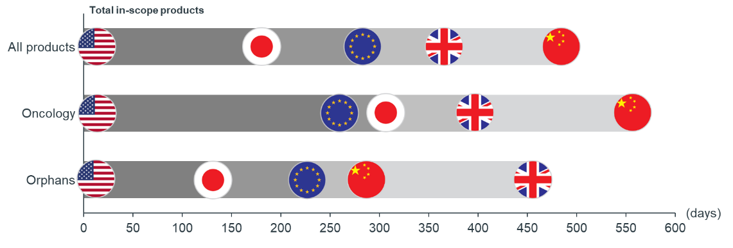
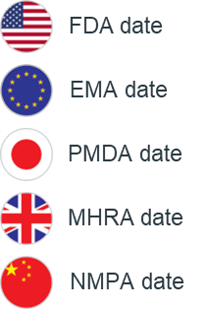
The products in-scope of the Portal received marketing authorisation later in Europe than in the US and Japan
Speed of marketing authorisation
Status of filing and reimbursement
Speed of filing and reimbursement
Root causes of delays
Key findings: Speed of marketing authorisation
Of all new products approved by international regulators between January 2021 and June 2022, EMA approval came later, on average, than the US and by Japan by 285 days and 110 days respectively; this is broadly consistent with academic literature over the last ten years
This gap closes to 229 days and 97 days with the US and Japan respectively for orphan products
For oncology drugs, European marketing authorisation typically happens 47 days earlier than Japan, although still lagging behind the US
This shows that even before considering the P&R process, Europe is slower in approving new products than the regulatory agencies in other regions¹
Date of EMA approvals relative to the US, UK, Japan and China
Legend:
No. of dates used to calculate averages:
 | FDA to EMA | FDA to PMDA | FDA to NMPA | FDA to MHRA
All products | 66 | 24 | 5 | 34
Oncology | 22 | 6 | 3 | 13
Orphans | 19 | 17 | 2 | 11
1. This lag may also be due – at least in part – to companies taking more time to file for marketing authorisation through the EMA compared to the FDA. Data on submission dates to the FDA and EMA are not publicly available.
Abbreviations: EMA = European Medicines Agency; FDA = Food and Drug Administration; MHRA = Medicines and Healthcare products Regulatory Agency; NMPA = National Medical Products Administration; PMDA = Pharmaceuticals and Medical Devices Agency

Slide 6
In many instances of product unavailability, the products have in fact been filed for reimbursement but have not yet been reimbursed
Speed of marketing authorisation
Status of filing and reimbursement
Speed of filing and reimbursement
Root causes of delays
Key findings: Status of filing and reimbursement
Looking at all products included in the Portal to date (which covers products that are on average 14 months post-marketing authorisation):
Taking an average across European countries, 56% of products have been filed for P&R. Of which:
41% of filed products have been reimbursed
59% of filed products are pending a reimbursement decision
The percentage of products that have been filed for P&R varies significantly with a higher percentage in larger European markets, than in smaller markets, particularly Central and Eastern Europe
Status of product reimbursement and filing across countries
0%
0%
0%
0%
0%
0%
0%
0%
0%
0%
0%
0%
0%
9%
13%
16%
16%
13%
13%
9%
6%
13%
22%
19%
25%
28%
28%
19%
28%
22%
22%
6%
25%
34%
25%
38%
31%
22%
41%
41%
44%
39%
31%
50%
56%
53%
63%
19%
28%
47%
44%
69%
19%
59%
69%
13%
16%
34%
50%
47%
63%
53%
31%
44%
63%
66%
78%
28%
31%
38%
47%
63%
33%
28%
28%
50%
47%
53%
50%
50%
44%
41%
41%
41%
38%
31%
31%
22%
25%
25%
38%
28%
28%
28%
25%
22%
19%
19%
9%
22%
23%
16%
16%
9%
9%
9%
6%
6%
6%
9%
3%
3%
3%
3%
3%
0%
Germany
Sweden
England
Austria
Scotland
Netherlands
Finland
Italy
France
Denmark
Belgium
Czech
Slovenia
Spain
Luxembourg
Slovakia
Ireland
Poland
Portugal
Estonia
Latvia
Greece
Norway
Croatia
Bulgaria
Romania
Lithuania
Cyprus
Malta
Hungary
Europe average
Reimbursed
Filed for P&R
Not filed for P&R
No information
Abbreviations: P&R = pricing and reimbursement

Slide 7
While there are delays in P&R filing for some products, this is not a key driver of low availability of medicines in all countries
Speed of marketing authorisation
Status of filing and reimbursement
Speed of filing and reimbursement
Root causes of delays
Key findings: Speed of filing and reimbursement
Proportion of time to reimbursement due to time to file for P&R
Although the Portal contains products that have been on the market for different lengths of time, across products that have been successfully reimbursed:
25% of the total time between EMA approval and availability can be attributed to the time between receiving EMA marketing authorization and P&R filing
75% of this time is attributable to the time between P&R filing and P&R decisions at the country-level
This pattern varies across countries: the proportion of the total time taken up by the time it takes a company to file for P&R is lowest in EU4+UK markets (19%) and highest in CEE (27%)
Sample size (total = 32)
5 | 3 | 4 | 12 | 4 | 5 | 9 | 9 | 6 | 7 | 7 | 3 | 7 | 7 | 8 | 7 | 11 | 7 | 11 | 6 | 7 | 5 | 3 | 8 | 7 | 8 | 6 | 8
France
Latvia
Austria
Spain
Sweden
Poland
Italy
Portugal
Norway
Lithuania
Ireland
Malta
Belgium
Czech
Luxembourg
Hungary
Slovenia
Romania
Slovakia
Greece
Finland
Cyprus
Estonia
Scotland
Netherlands
Denmark
Bulgaria
Croatia
Europe average
Note: Data are not available for all products in all countries. Where the sample size of products in any given country was less than 3 (Germany and England), these countries have been removed from the figure. This is due to the risk of bias in the results from a very small number of products and due to the risk of de-anonymising individual products.
Abbreviations: CEE = Central and Eastern Europe; P&R = pricing and reimbursement

Slide 8
As set out in the root causes analysis, the reasons for both delays in P&R filing and P&R decision making are multi-factorial
Speed of marketing authorisation
Status of filing and reimbursement
Speed of filing and reimbursement
Root causes of delays
Key findings: Reasons for not filing for P&R
The most common reasons for not filing for P&R were related to the requirements of the P&R process and health system constraints and resources
However, these reasons clearly vary between regions of Europe:
Delays in filing in Western Europe are largely due to the value assessment process and evidence requirements
Delays in filing in Central and Eastern Europe are largely due to health system constraints and the corresponding impact this has on commercial decision-making and resource allocation
The data collected in the Portal will mature as more cycles of data are collected. This will allow us to validate some of these early results and to look in more detail at the underlying root causes
Proportion of time to reimbursement due to time to file for P&R
Health system constraints and resources
P&R process
Value assessment process
Preparing to file
Number of times this reason was provided
0
CEE
Mid-size Western
Nordic
EU4+UK
Abbreviations: CEE = Central and Eastern Europe; P&R = pricing and reimbursement

Slide 9
There is significant variation in the reason certain products have not filed for reimbursement in all European countries
Speed of marketing authorisation
Status of filing and reimbursement
Speed of filing and reimbursement
Root causes of delays
This grid shows that there is significant variation across products. This is, in part, due to the length of time since the marketing authorization, but also because of the different types of product included
Anonymised distribution of product-level P&R filing across countries
 | Anonymised product-level information (N=32)
Netherlands |  |  |  |  |  |  |  |  |  |  |  |  |  |  |  |  |  |  |  |  |  |  |  |  |  |  |  |  |  |  |  |  | 88%
Germany |  |  |  |  |  |  |  |  |  |  |  |  |  |  |  |  |  |  |  |  |  |  |  |  |  |  |  |  |  |  |  |  | 84%
Spain |  |  |  |  |  |  |  |  |  |  |  |  |  |  |  |  |  |  |  |  |  |  |  |  |  |  |  |  |  |  |  |  | 84%
Italy |  |  |  |  |  |  |  |  |  |  |  |  |  |  |  |  |  |  |  |  |  |  |  |  |  |  |  |  |  |  |  |  | 81%
England |  |  |  |  |  |  |  |  |  |  |  |  |  |  |  |  |  |  |  |  |  |  |  |  |  |  |  |  |  |  |  |  | 78%
Denmark |  |  |  |  |  |  |  |  |  |  |  |  |  |  |  |  |  |  |  |  |  |  |  |  |  |  |  |  |  |  |  |  | 75%
Finland |  |  |  |  |  |  |  |  |  |  |  |  |  |  |  |  |  |  |  |  |  |  |  |  |  |  |  |  |  |  |  |  | 75%
Sweden |  |  |  |  |  |  |  |  |  |  |  |  |  |  |  |  |  |  |  |  |  |  |  |  |  |  |  |  |  |  |  |  | 75%
Belgium |  |  |  |  |  |  |  |  |  |  |  |  |  |  |  |  |  |  |  |  |  |  |  |  |  |  |  |  |  |  |  |  | 72%
Portugal |  |  |  |  |  |  |  |  |  |  |  |  |  |  |  |  |  |  |  |  |  |  |  |  |  |  |  |  |  |  |  |  | 72%
Austria |  |  |  |  |  |  |  |  |  |  |  |  |  |  |  |  |  |  |  |  |  |  |  |  |  |  |  |  |  |  |  |  | 69%
France |  |  |  |  |  |  |  |  |  |  |  |  |  |  |  |  |  |  |  |  |  |  |  |  |  |  |  |  |  |  |  |  | 66%
Ireland |  |  |  |  |  |  |  |  |  |  |  |  |  |  |  |  |  |  |  |  |  |  |  |  |  |  |  |  |  |  |  |  | 66%
Luxembourg |  |  |  |  |  |  |  |  |  |  |  |  |  |  |  |  |  |  |  |  |  |  |  |  |  |  |  |  |  |  |  |  | 59%
Scotland |  |  |  |  |  |  |  |  |  |  |  |  |  |  |  |  |  |  |  |  |  |  |  |  |  |  |  |  |  |  |  |  | 59%
Czechia |  |  |  |  |  |  |  |  |  |  |  |  |  |  |  |  |  |  |  |  |  |  |  |  |  |  |  |  |  |  |  |  | 56%
Greece |  |  |  |  |  |  |  |  |  |  |  |  |  |  |  |  |  |  |  |  |  |  |  |  |  |  |  |  |  |  |  |  | 56%
Slovenia |  |  |  |  |  |  |  |  |  |  |  |  |  |  |  |  |  |  |  |  |  |  |  |  |  |  |  |  |  |  |  |  | 56%
Norway |  |  |  |  |  |  |  |  |  |  |  |  |  |  |  |  |  |  |  |  |  |  |  |  |  |  |  |  |  |  |  |  | 53%
Slovakia |  |  |  |  |  |  |  |  |  |  |  |  |  |  |  |  |  |  |  |  |  |  |  |  |  |  |  |  |  |  |  |  | 47%
Bulgaria |  |  |  |  |  |  |  |  |  |  |  |  |  |  |  |  |  |  |  |  |  |  |  |  |  |  |  |  |  |  |  |  | 44%
Poland |  |  |  |  |  |  |  |  |  |  |  |  |  |  |  |  |  |  |  |  |  |  |  |  |  |  |  |  |  |  |  |  | 44%
Romania |  |  |  |  |  |  |  |  |  |  |  |  |  |  |  |  |  |  |  |  |  |  |  |  |  |  |  |  |  |  |  |  | 44%
Hungary |  |  |  |  |  |  |  |  |  |  |  |  |  |  |  |  |  |  |  |  |  |  |  |  |  |  |  |  |  |  |  |  | 38%
Estonia |  |  |  |  |  |  |  |  |  |  |  |  |  |  |  |  |  |  |  |  |  |  |  |  |  |  |  |  |  |  |  |  | 34%
Croatia |  |  |  |  |  |  |  |  |  |  |  |  |  |  |  |  |  |  |  |  |  |  |  |  |  |  |  |  |  |  |  |  | 31%
Lithuania |  |  |  |  |  |  |  |  |  |  |  |  |  |  |  |  |  |  |  |  |  |  |  |  |  |  |  |  |  |  |  |  | 28%
Cyprus |  |  |  |  |  |  |  |  |  |  |  |  |  |  |  |  |  |  |  |  |  |  |  |  |  |  |  |  |  |  |  |  | 25%
Latvia |  |  |  |  |  |  |  |  |  |  |  |  |  |  |  |  |  |  |  |  |  |  |  |  |  |  |  |  |  |  |  |  | 19%
Malta |  |  |  |  |  |  |  |  |  |  |  |  |  |  |  |  |  |  |  |  |  |  |  |  |  |  |  |  |  |  |  |  | 13%
 | 100% | 97% | 93% | 90% | 83% | 80% | 80% | 80% | 80% | 77% | 73% | 70% | 70% | 70% | 67% | 63% | 60% | 60% | 53% | 47% | 43% | 43% | 43% | 40% | 37% | 37% | 20% | 20% | 13% | 10% | 3% | 0%
The reason for delayed filing varied from product to product. For some groups of products, the impact of external reference pricing was a key driver. In other cases, ‘country filing requirements’ was listed as one of the reasons for non-submission

Slide 10
Key conclusions of the first European Access Hurdles Portal report
There is a willingness from industry to provide more transparency on the root causes of unavailability, with almost 90% of eligible EFPIA companies submitting data to the Portal
The data collected in the Portal has generated new insights on delay and lack of availability:
These findings indicate that availability of centrally authorized medicines to patients in European countries is a shared responsibility, requiring a shared solution
This is the first report from the Portal; thus, the data are exploratory and cannot be used to infer the impact of EFPIA members’ commitment to file. The data collected in the Portal will mature as more cycles of data are collected. This will allow us to validate some of these early results and to look in more detail at the underlying root causes
Speed of marketing authorisation
Status of filing and reimbursement
Speed of filing and reimbursement
Root causes of delays
Even before considering the P&R process, new products received regulatory approval later in Europe than in other regions
In many instances of product unavailability, the products have in fact been filed for reimbursement but have not yet been reimbursed
While there are delays in P&R filing for some products in some countries, this is not a key driver of low availability of medicines in all countries
The reasons for both delays in P&R filing and P&R decision-making are multi-factorial, commonly relating to requirements of the P&R process and health system constraints

